Slide 1
Vintage Snake Game
By GOWTHAM

Slide 2
IDEA OF THE GAME
Our idea is to recreate the old games to this morden age.
So this game is the first step for that
We recreated our old childhood memory of the snake game we used to play on nokia 1100.
And also planned to produce the simple and small effective game.

Slide 3
CREATION
This game is mainly created with the help of HTML, CSS and JavaScript.
We use HTML for the HTML markups
CSS for the Styling of the HTML and Environment.
JS for the functionality of the game.

Slide 4
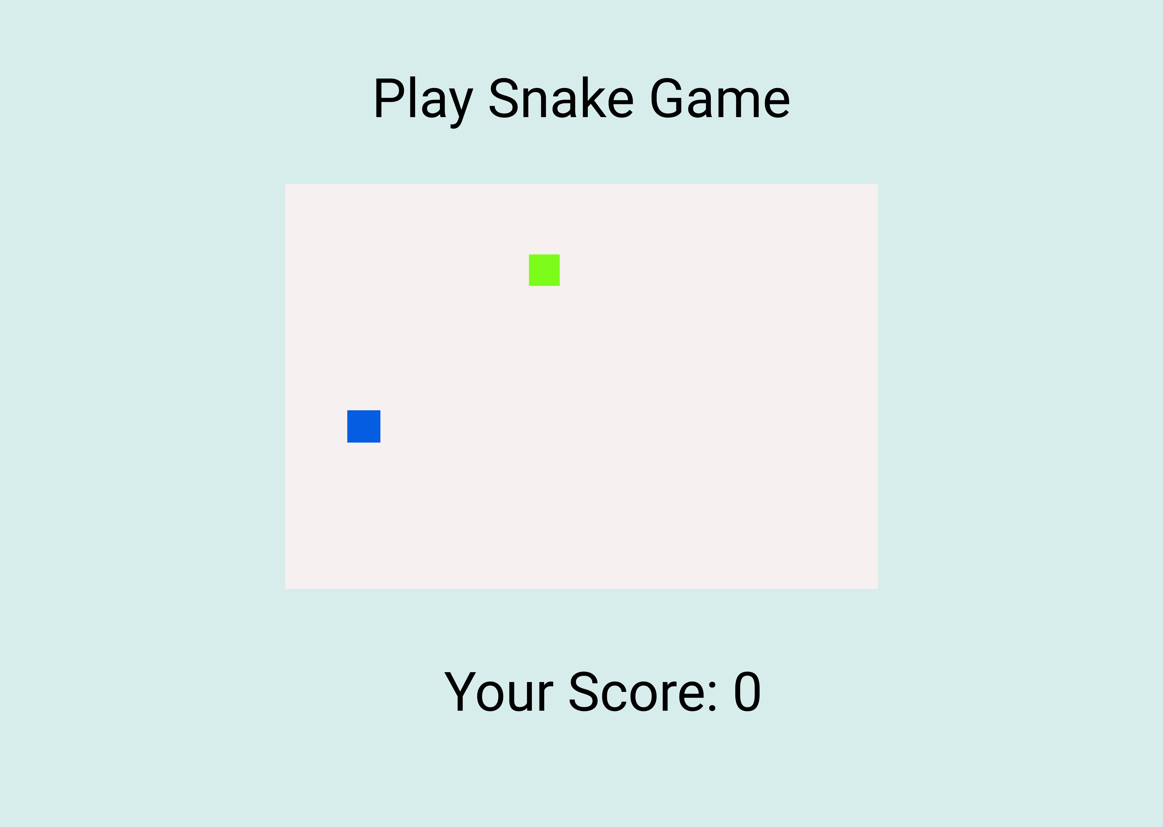
WIREFRAME MODEL

Slide 5
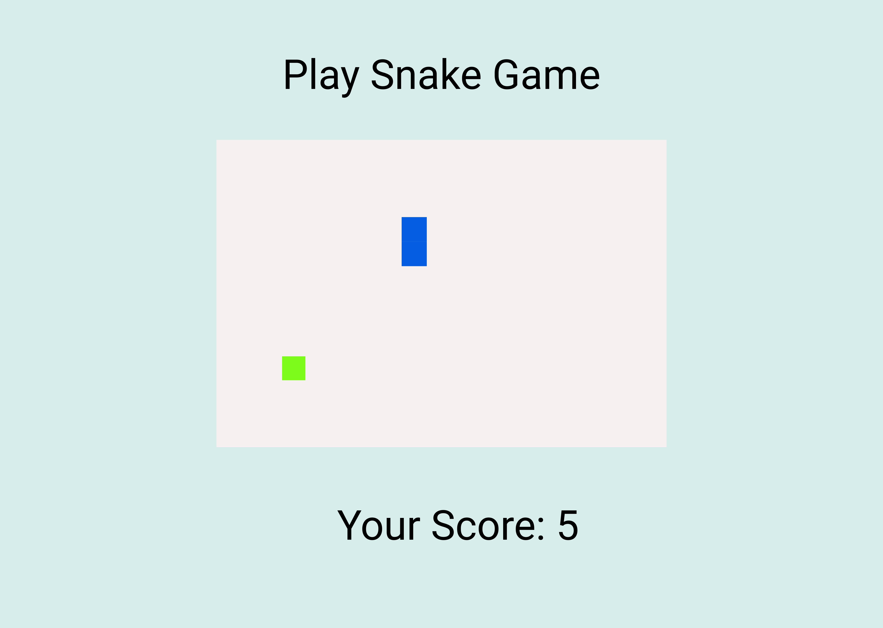

Slide 6
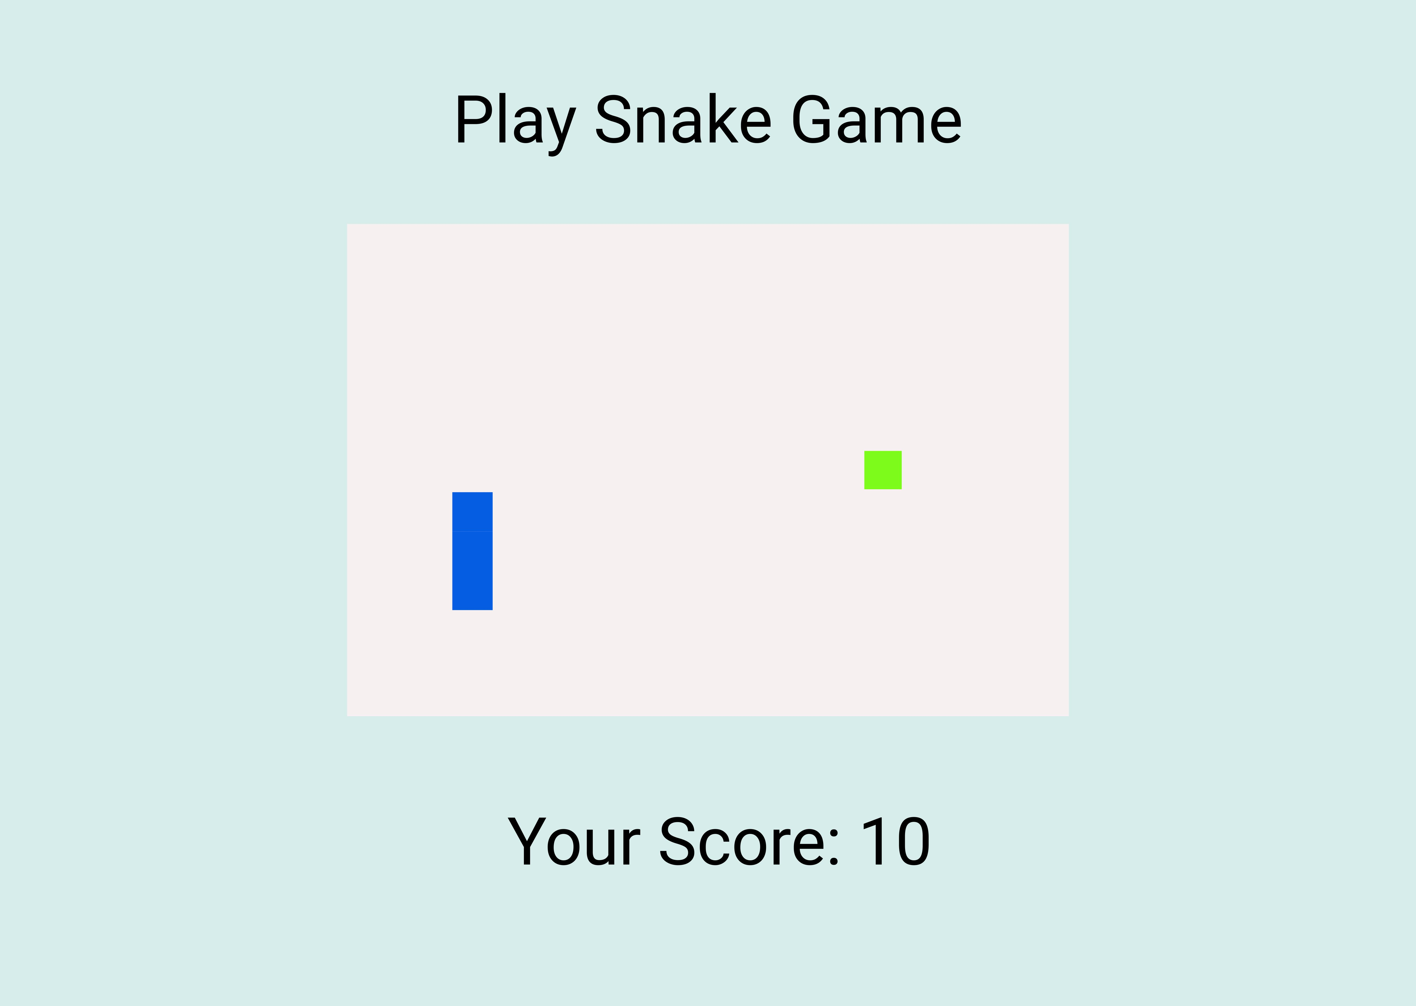

Slide 7
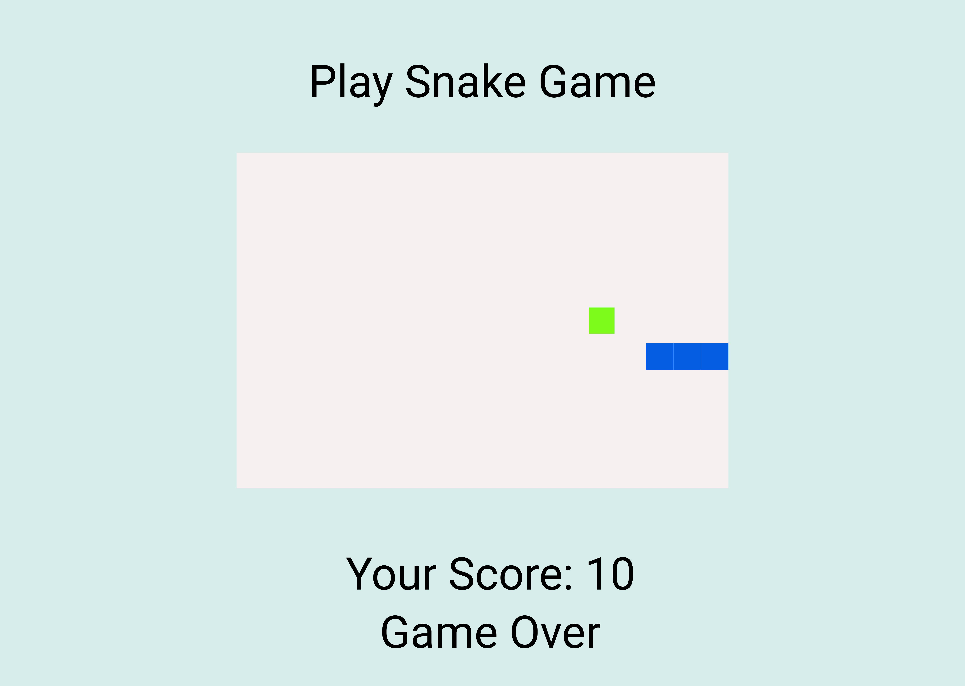

Slide 8
RULES TO PLAY
Rule.No:1 : You need to move the snake to catch the frog.
Rule.No:2 : If you Catch the frog you will get 5 points.
Rule.No:3 : Every time you catch the frog the score increaes.
Rule.No:4 : Don’t Hit the borders if you hit the borders Game Over.

Slide 9
PLACEMENTS & CONTROLLS
You can see the play area in the middle of the web page.
You can see your score in the bootom of the play area.
With the help of the “Space Button” you can pause and resume the game.
With the help of the “Arrow Keys” you can controll the snakes.

Slide 10
Thanking You

